Slide 1
The best place for a pizza connoisseur to eat pizza.

Slide 2
5 Major Cities in the US with lots of pizza places:
New York
San Francisco
Jersey City
Boston
Chicago

Slide 3
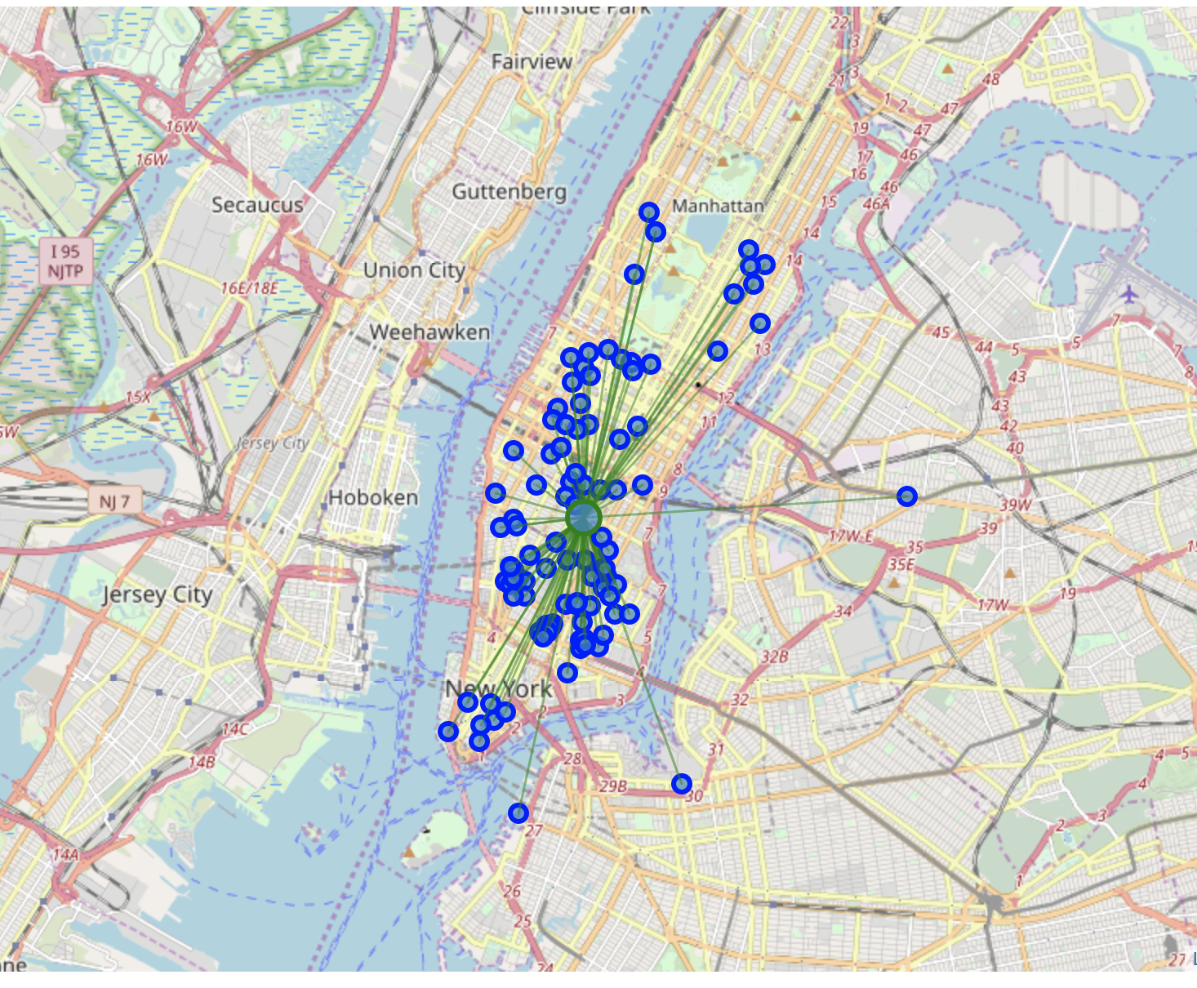
Density of pizza places in New York City

Slide 4
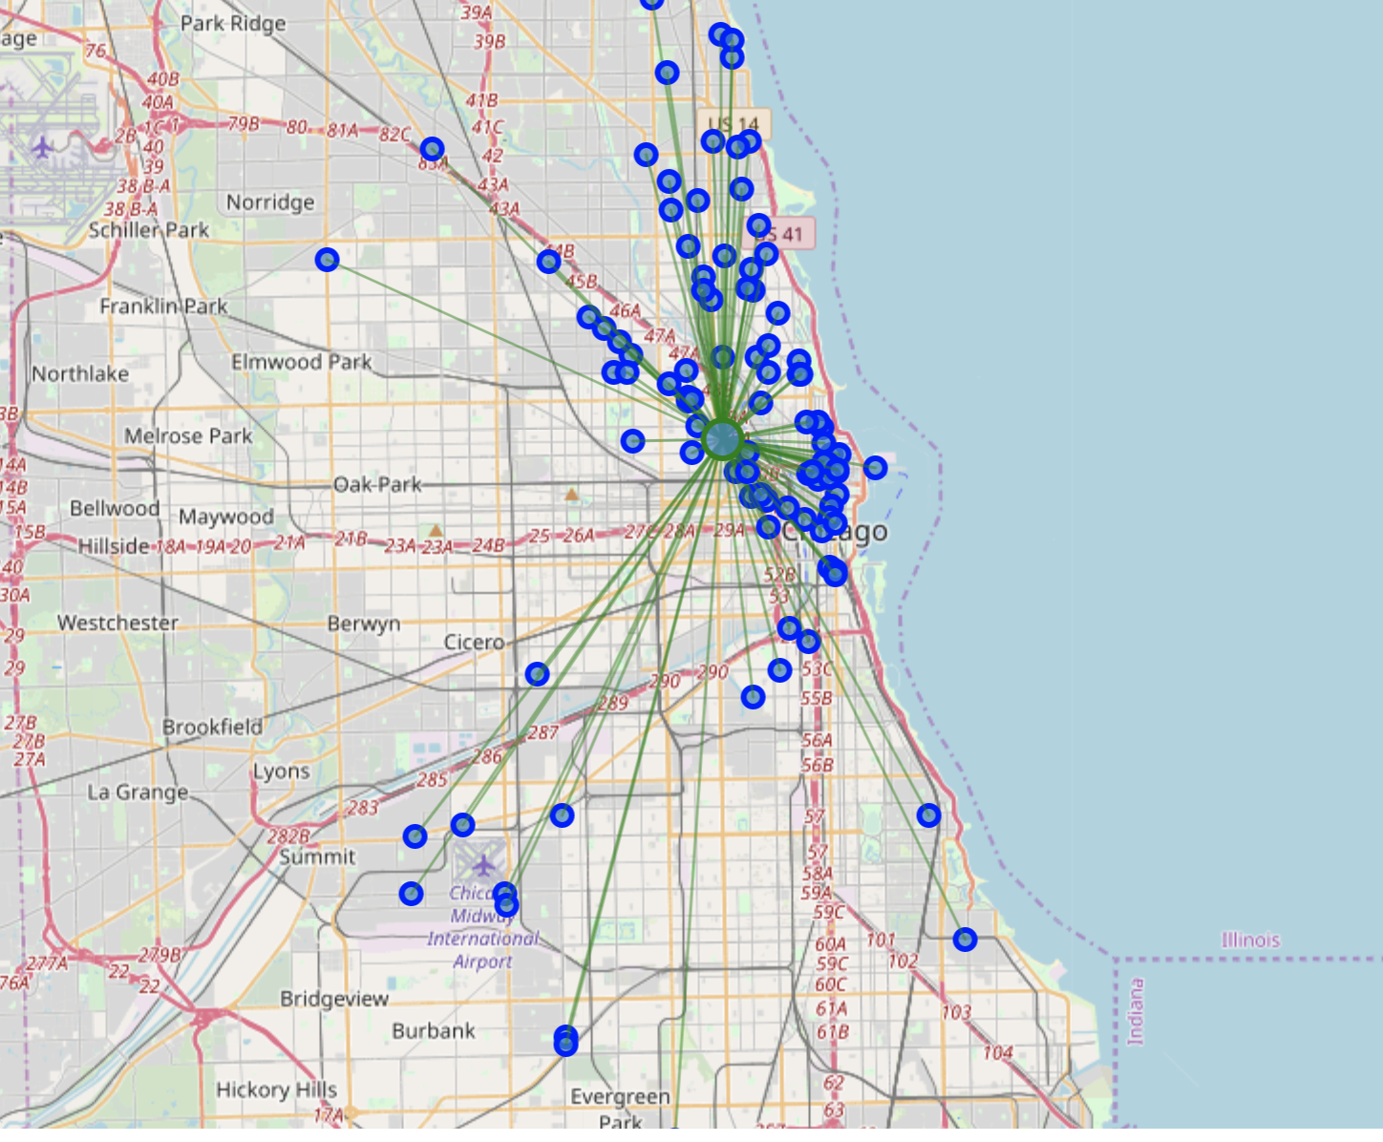
Density of pizza places in Chicago

Slide 5
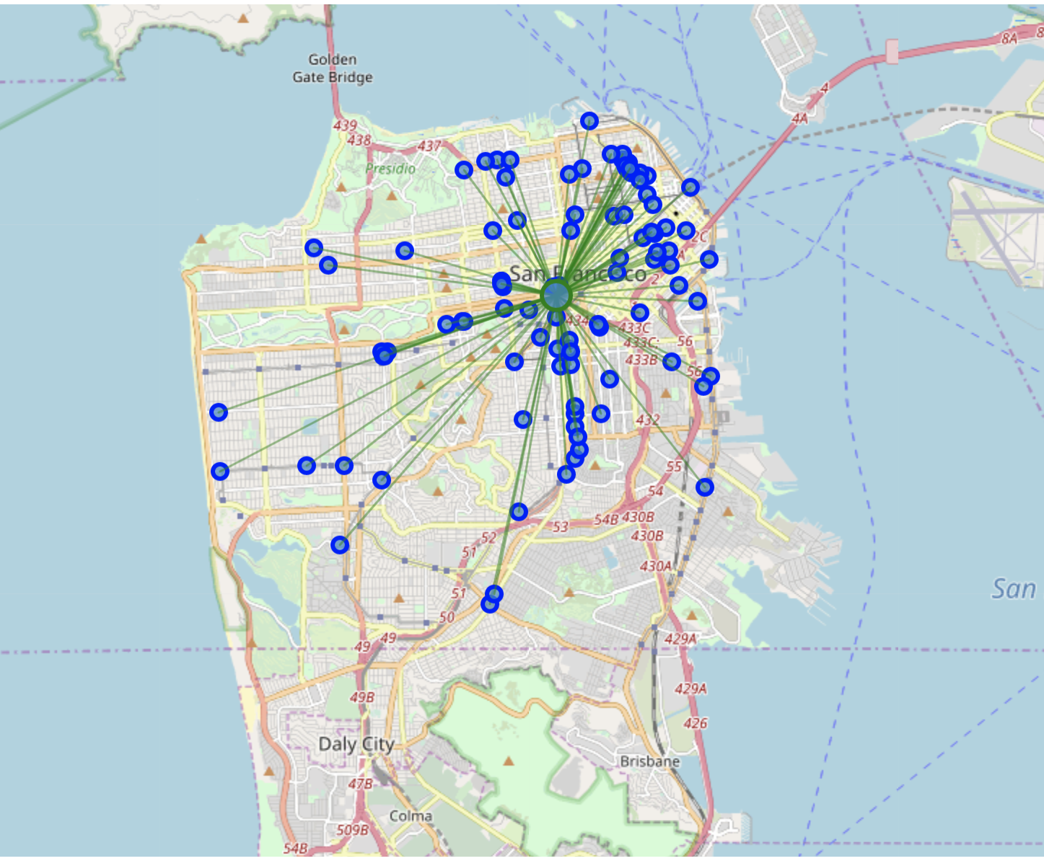
Density of pizza places in San Francisco

Slide 6
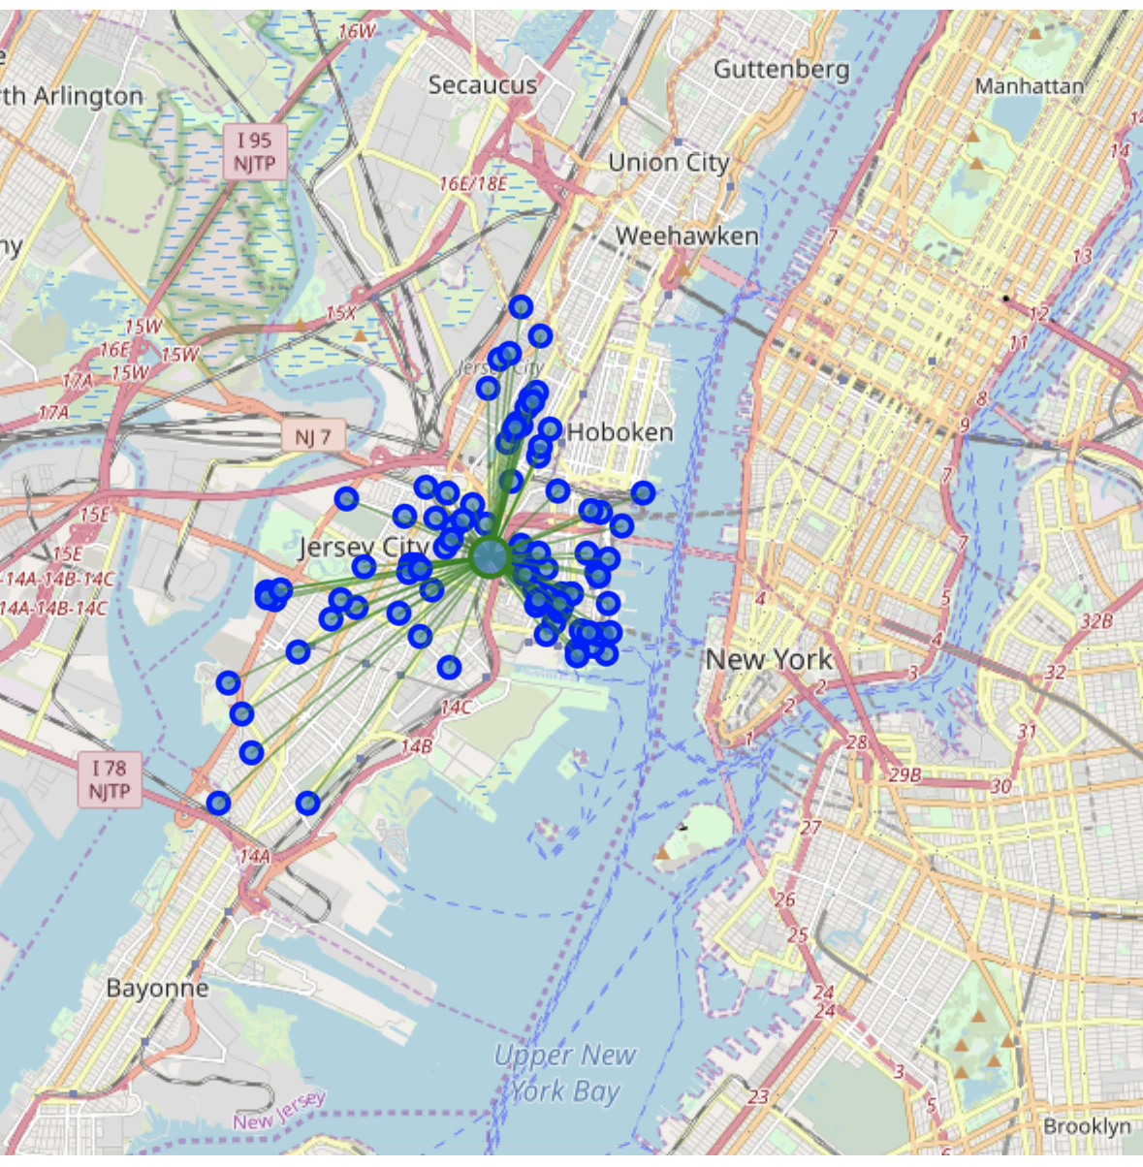
Density of pizza places in Jersey City

Slide 7
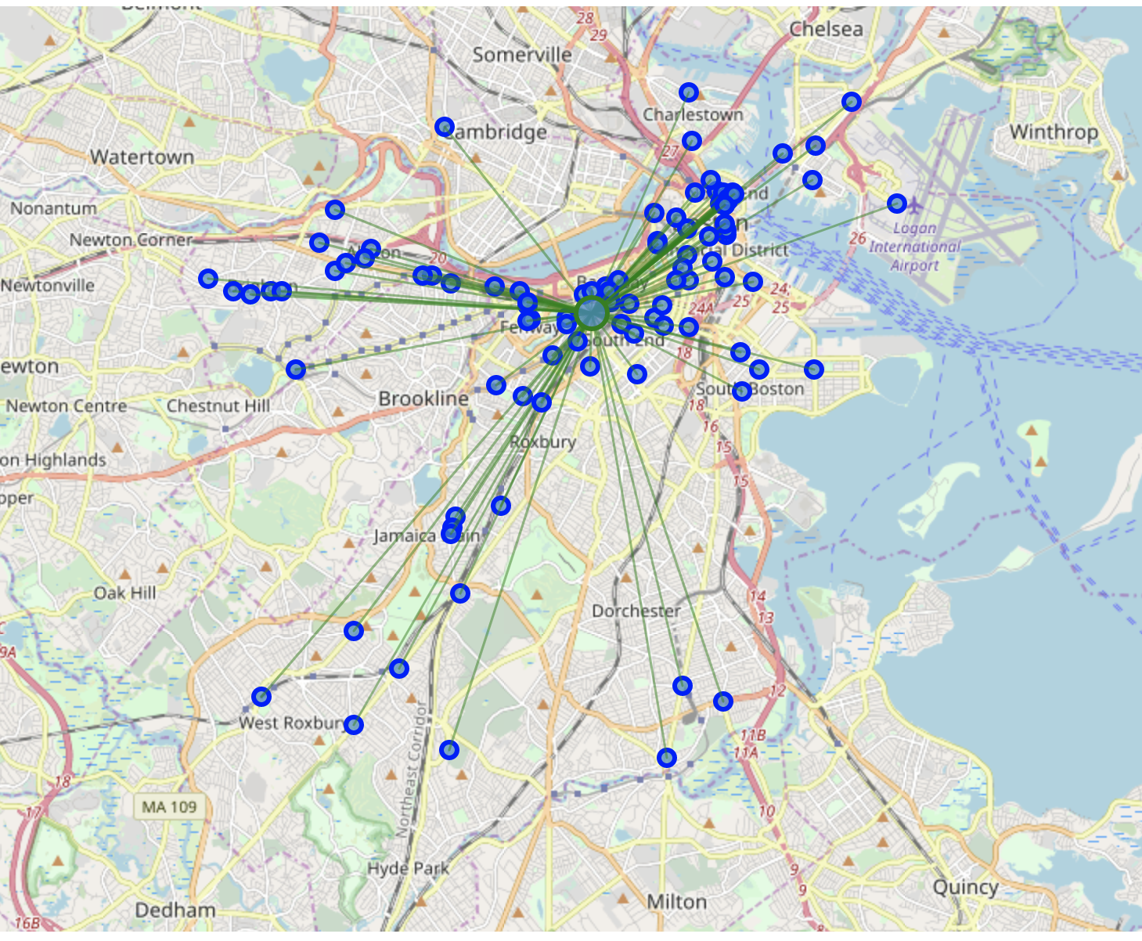
Density of pizza places in Boston

Slide 8
How did I figure out which city is best?
Calculated the center of the pizza places represented by the large green circle on the maps(mean coordinate)
Calculated the distance of each pizza place to the center( Mean distance to mean coordinate)
Lastly, I ranked the cities based on the smallest distances.

Slide 9
Results
From largest density of pizza places to lowest:
1)New York
2)San Francisco
3)Jersey City
4) Boston
5)Chicago

